Slide 1











We are
SCRIPTORIA
where ideas fuse and minds muse

Slide 2



Slide 4


Slide 5


































Allow your imagination to take place with our storytelling website specific for comic book enthusiasts, anime fans, and storytellers alike.
MERN

Slide 6





Problems
Communication Writing alone involves solitude, it lacks social engagement and collaboration which can make it difficult for authors to enhance their skills
Discoverability There are limited platforms available for creating a fanbase or enjoying one.
Publishing It is an important concern for writers to find a place to share their Writings, real-life publishing can cost you money.
Diversity and Cultural Barriers Neglecting diverse perspectives and limiting the audience base, this results in a narrow range of stories.

Slide 7





COMPETITIVE ADVANTAGE

Slide 8





DO YOU OFFER A REAL-TIME CHAT feature?
NO, YOU CAN CHAT WITH YOUR FRIENDS BUT YOU HAVE TO REFRESH THE PAGE EVERY TIME TO SEE UPDATES.

Slide 9







CAN I COLLABORATE WITH FELLOW WRITERS TO WRITE TOGETHER?
NO, WE DON’T OFFER THIS FEATURE
NEITHER DO WE
...

Slide 10






CAN I PUBLISH MY STORIES ON
your platform?
NO, WE ALLOW YOU TO ONLY READ THE STORIES WE OFFER
SAME HERE

Slide 11




TELL ME ABOUT YOUR WEBSITE’S
DIVERSITY IN STORY CONTENT
DIVERSITY... ?

Slide 12

It enables creators to work together on projects, co-create stories, and engage in collective storytelling experiences, fostering creativity, teamwork, and shared ownership of content.
Collaborative Storytelling
It offers a strong sense of community among creators and fans, enabling meaningful interactions and discussions. Users can connect, share, and engage in feedbacks.
SCRIPTORIA STANDS OUT FOR ITS EMPHASIS ON
Community Engagement
It focusses on a rich exchange of stories, perspectives, and artistic styles by enabling creators to share diverse stories and characters, which enriches the content available to readers.
Diversity and inclusivity
Discovery and Recognition
It leverages aspiring creators to be discovered, build a fanbase, and gain recognition. It facilitates exposure and opportunities for creators to showcase their talent and grow their audience.

Slide 14
Archive of our own
WATTBAD

Slide 15
1.98 Billion USD
12.15 Billion USD
27.8 Billion USD
1.30 Billion USD
10.32 Billion USD
118.8 Billion USD
Comics market
Manga market
Online Book services Market
Market size value
in 2023
Revenue forecast
in 2032
CAGR= 4.9%.
Market size value
in 2022
Revenue forecast
in 2032
CAGR= 17.7%.
Market size value
in 2020
Revenue forecast
in 2027
CAGR=5.8%.

Slide 16
React: A front-end JavaScript library developed by Facebook for building user interfaces, particularly applications where dynamic content updates are crucial. React allows developers to create reusable UI components, manage the state efficiently, and improve performance with its virtual DOM.
Express js: A lightweight and flexible web application framework for Node.js that provides a robust set of features to develop web and mobile applications. It facilitates the handling of HTTP requests, routing, and middleware, making it easier to build robust APIs and web servers.
MongoDB: is a document-oriented database that stores all of its data as Binary JSON (BSON) documents. This allows for flexible, hierarchical data structures, making it easy to evolve the data model. MongoDB is known for its scalability and performance, especially for applications with large volumes of data and high transaction loads.
Node js A JavaScript runtime environment built on Chrome's V8 engine that enables server-side scripting. Node.js is designed for building scalable network applications, capable of handling numerous simultaneous connections with high throughput. It uses an event-driven, non-blocking I/O model, making it ideal for real-time applications.
M
E
MERN
R
N
STACK

Slide 17


MONGODB
a document-oriented database that stores all of its data as Binary JSON (BSON) documents.
BSON allows you to serialize many forms of data.
Using BSON documents allows you to store unstructured, semi-structured, and structured data. Instead of a database schema, MongoDB uses a flexible approach, storing documents in collections.
MONGODB
a document-oriented database that stores all of its data as Binary JSON (BSON) documents.
BSON allows you to serialize many forms of data.
Using BSON documents allows you to store unstructured, semi-structured, and structured data. Instead of a database schema, MongoDB uses a flexible approach, storing documents in collections.
@reallygreatsite
Read More
Read More

Slide 18

MongoDB design offers a significant advantage in terms of scalability. It has two key features for scaling:
· Replica sets—groups of MongoDB
servers that hold identical data
· Sharding—different parts of your data
distributed across different servers
MongoDB allows you to create sharded clusters, so portions of your data are replicated across multiple servers. For example, if you have a large number of customer records, you can distribute them so that names from A-J and names from K-Z are in their own replica set. MongoDB can thus scale horizontally to optimize both read and write performance at scale.
MongoDB documents follow a hierarchical data model and keep most of the data in a single document, reducing the need for joins across multiple documents.
Joins are supported via the $lookup operation, but they are not optimized for performance. However, MongoDB offers an insertMany() API for rapidly inserting data, prioritizing write performance.
By storing data as JSON documents, MongoDB lets you build complicated applications with many distinct data types. For instance, you can create new fields by updating nested array fields. You can also use an aggregation pipeline—a MongoDB feature that lets you transform data by combining multiple operations into a single workflow.
SCALABILITY
PERFORMANCE

Slide 19
MongoDB uses authentication, access control, and encryption to ensure the security of their databases.
It uses TLS/SSL encryption to protect data in transit and at rest.
It also allows you to define different levels of user access.
SECURITY
MongoDB uses indexing to improve query speeds and performance.
Indexes are database structures that link to frequently accessed data. The index helps find and retrieve data very quickly.
It uses hash indexes, B-tree indexes, and several others.
INDEXING SUPPORT
Within MongoDB, you can control access on an operation, collection, or database level. It uses Kerberos, X.509, and LDAP certificates to authenticate users.
ACCESS CONTROL

Slide 20

01
Plan
06
02
Review
Design
Sprint 5
Sprint 4
Sprint 3
Sprint 2
Sprint 1
SPRINTS
Deploy
Develop
March 4th
05
03
April 20th
April 4th
March 27th
March 10th
Test
04

Slide 21

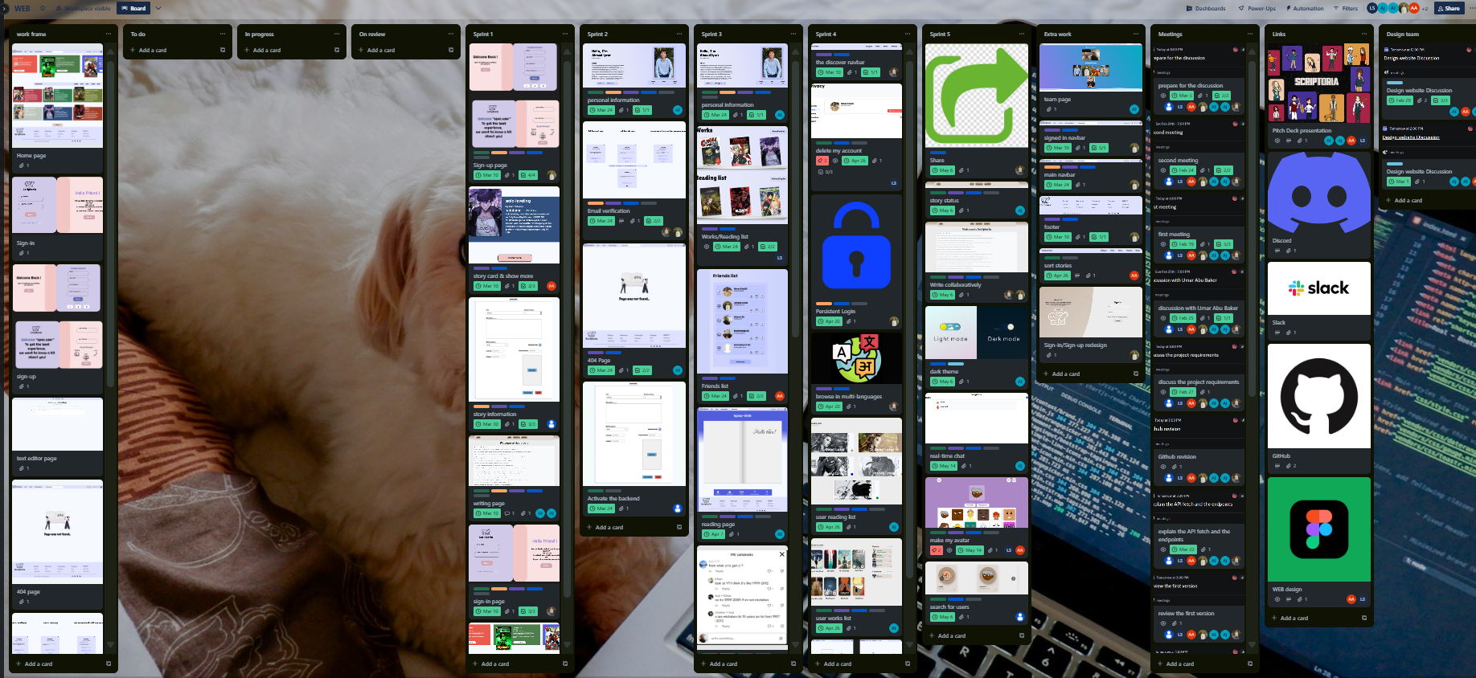

We used Kanban methodology to manage our project
Our Trello
Notes:
done
extra work
meetings
work frame
links

Slide 22






Slide 23



Slide 24

Nellie
Laila
Johnny
Brady
Allie

Slide 25



Laila
Johnny
Allie
Brady
Nellie

Slide 26



Comic Collector “Laila”, 18 years old, a passionate comic book reader and collector.
Goals: Discover new comics, engage with community, participate in events, share favorites.
Preferences: Enjoys reading platforms, active in fan communities, attends comic conventions.
Needs Met by Scriptoria: Comic discoveries, community engagement, event participation, sharing favorite comics.

Slide 27


Writer “Johnny”, 32 years old, a writer exploring comic storytelling.
Goals: Develop writing skills, collaborate with artists, publish work, connect with readers. Preferences: Writing enthusiast, seeks collaboration opportunities, values reader interaction.
Needs Met by Scriptoria: Writing resources, artist collaboration tools, publishing platform, reader feedback.

Slide 28

Creator “Allie”, 27 years old, a freelance artist and writer.
Goals: Collaborate on projects, share work, receive feedback.
Preferences: Experienced in digital art, active in comic creator communities, values feedback and recognition.
Needs Met by Scriptoria: Collaboration tools, community feedback, monetization options, exposure to wider audience.

Slide 29
Diverse Style Sharer “Brady”, 21 years old, a writer with a unique sense of style.
Goals: Share unique styles, promote diversity, collaborate, connect. Preferences: Creates diverse content, engages in diversity discussions, share cross cultural stories.
Needs Met by Scriptoria: Platform for diverse content, community support, and cross-cultural exchange.

Slide 30

Aspiring Creator “Nellie, 20 years old, a writer exploring comic storytelling. Goals: Showcase talent, gain exposure, build fan base, seek a wide audience. Preferences: Active on social media, seeks mentorship, values feedback. Needs Met by Scriptoria: Exposure to wider audience, community engagement.

Slide 31




Special thanks to
Obada Khalili
Samer Huwari
Umar Abu Baker

Slide 32

We are
SCRIPTORIA

